Slide 1

GLOBAL EDUCATION
GLOBAL

Slide 2
ABSTRACT
Education is regarded as a quintessential resource for people and civilizations alike. Indeed, in most countries, basic education is now seen not just as a right, but also as a responsibility: governments are often expected to ensure access to basic education, and citizens are frequently required by law to obtain education up to a particular degree.
We begin by offering an overview of long-term trends in education outcomes and outputs around the world, concentrating on both quantity and quality indicators of educational attainment; and then we analyze the data available on the determinants and consequences of education.
With each country's population in mind, we analyze literacy rates, government expenditure on education, which country ranks highest in terms of education spending, what percentage of a country's population receives the minimum vs advanced education, primary and secondary schooling with years and finally we compare countries based on average harmonized learning score.

Slide 3
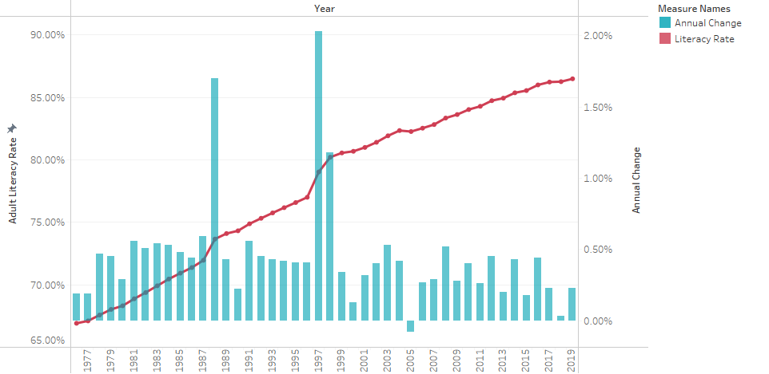
WORLD LITERACY RATE 1976-2021
Adult literacy rate is the percentage of people ages 15 and above who can both read and write with understanding a short simple statement about their everyday life.
World literacy rate for 2019 was 86.48%, a 0.23% increase from 2018
World literacy rate for 2005 was 82.26%, a 0.08% decrease from 2004.

Slide 4
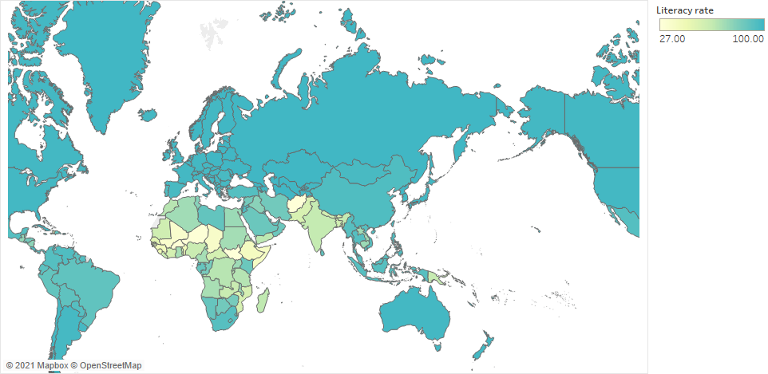
LITERACY RATE ( 2021 )
It is evident from the map that African countries have the lowest literacy rates in the world.
The 7 superpowers of the world have a very high literacy rate.
Other developed countries such as Canada, Australia also lead in the same.
Unlike other continents, there is a great disparity in rate of literacy in the continent of Asia.

Slide 5
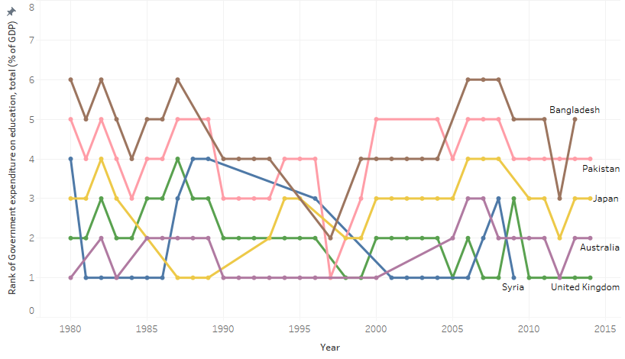
RANKING OF COUNTRIES BASED ON EXPENDITURE ON EDUCATION (% GDP)
We can say as the global earnings – as measured by GDP per capita – are rising, the total amount of global resources spent on education is expanding in absolute terms as well.
The countries are increasing investment in education, small but significant for the past 2 decades.
As it is evident from the chart, Syrian government put a lot of efforts in supporting the education despite facing socio-economic problems. But with the start of war in 2011, Syria lost its majority student population by 2015 due to displacement of millions Syrians.
Countries like UK and Australia seem to be making consistent efforts in expenditure on education.

Slide 6
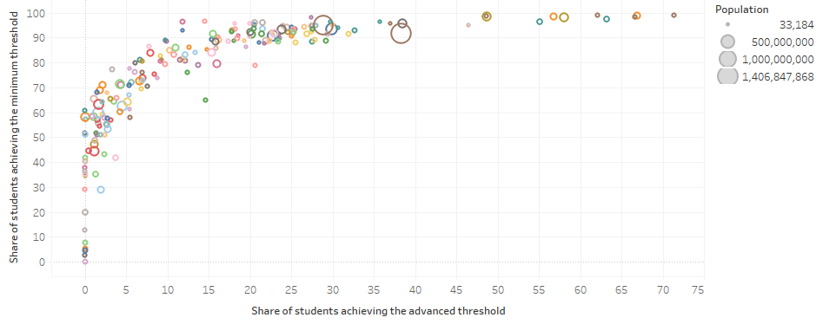
SHARE OF STUDENTS ACHIEVING THE MINIMUM THRESHOLD VS ADVANCED THRESHOLD
This chart shows the share of students who achieve minimum proficiency against the share who achieve advanced proficiency.
Minimum Threshold is defined as the proportion of population who pass a global benchmark for minimum skills and the proportion who pass a global benchmark for advanced skills is Advanced Threshold.
The size of the circles are based on population of the country.
Here we can see that the largest circle are for China and India but despite that the advanced threshold learning outcome is considerably low.
On the other hand, the highest minimum and advanced threshold is of Singapore.

Slide 7
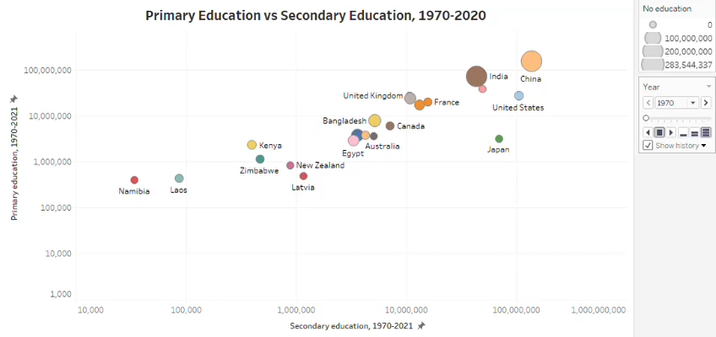
PRIMARY AND SECONDARY EDUCATION OVER THE YEARS
This connected scatterplot is plotted between Primary Education and Secondary Education throughout the years 1970-2021 for different countries.
The size of the circle represents the country with highest proportion of people with No education.
We can infer that despite the primary and secondary education being high for countries like India and China, there are also the highest number of people with no education in these countries.

Slide 8
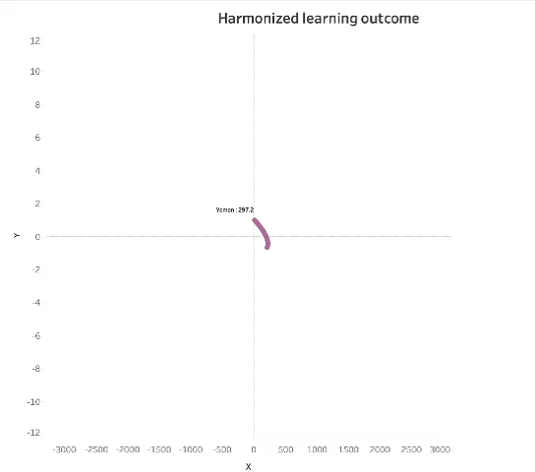
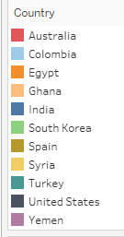
AVERAGE HARMONISED LEARNING OUTCOME SCORE
The Harmonized Learning Outcome is a score that measures education not by years in school or degrees earned, but by knowledge, skills and abilities individual students should possess and can demonstrate upon completion of a learning experience.
Average scores across standardized, psychometrically-robust international and regional student achievement tests. In order to maximize coverage by country, tests have been harmonized and pooled across subjects (math, reading, science) and levels (primary and secondary education).
It is evident from the chart that South Korea has the highest score, and Yemen has the lowest score.

Slide 9
THANK YOU !

